Slide 1

Natural Language Processing
Yue Zhang
Westlake University

Slide 2
Chapter 6
Hidden Variables

Slide 3
Contents
6.1 Expectation Maximization
6.1.1 Introduction
6.1.2 EM
6.1.3 Relationships between MLE and EM
6.2 Using EM
6.2.1 Unsupervised Naïve Bayes model
6.2.2 IBM Model 1
6.2.3 Probabilistic latent semantic analysis
6.2.4 The relative advantages of generative models
6.3 EM theory
6.3.1 EM and KL-Divergence
6.3.2 EM derivation using numerical optimization

Slide 4
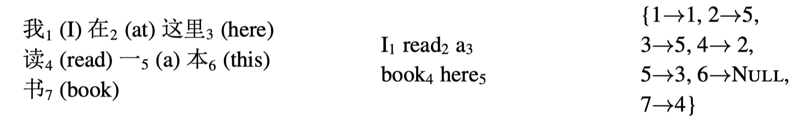
Hidden Variables
Examples
Large unlabeled text corpora for low-resource languages and domains
Labelled alignment between word pairs in a sentence pair for Machine Translation
I love NLP
我 爱 自然语言处理
MLE by counting relative frequency is infeasible

Slide 5
Contents
6.1 Expectation Maximization
6.1.1 Introduction
6.1.2 EM
6.1.3 Relationships between MLE and EM
6.2 Using EM
6.2.1 Unsupervised Naïve Bayes model
6.2.2 IBM Model 1
6.2.3 Probabilistic latent semantic analysis
6.2.4 The relative advantages of generative models
6.3 EM theory
6.3.1 EM and KL-Divergence
6.3.2 EM derivation using numerical optimization

Slide 6
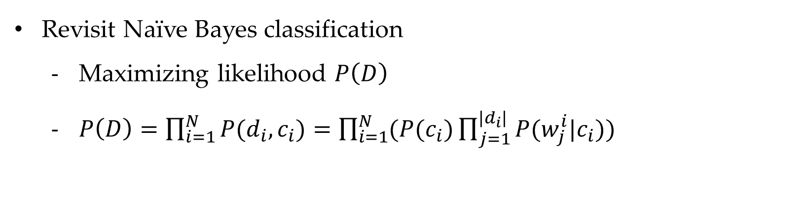
Dealing with Hidden Variables
Revisit Naïve Bayes classification
Maximizing likelihood $P\left(D\right)$
$P\left(D\right)=\prod_{i=1}^{N}{P(d_{i},c_{i})}=\prod_{i=1}^{N}{(P(c_{i})}\prod_{j=1}^{{|d}_{i}|}{P(w_{j}^{i}|c_{i})})$
Notes:
P(O,H)

Slide 7
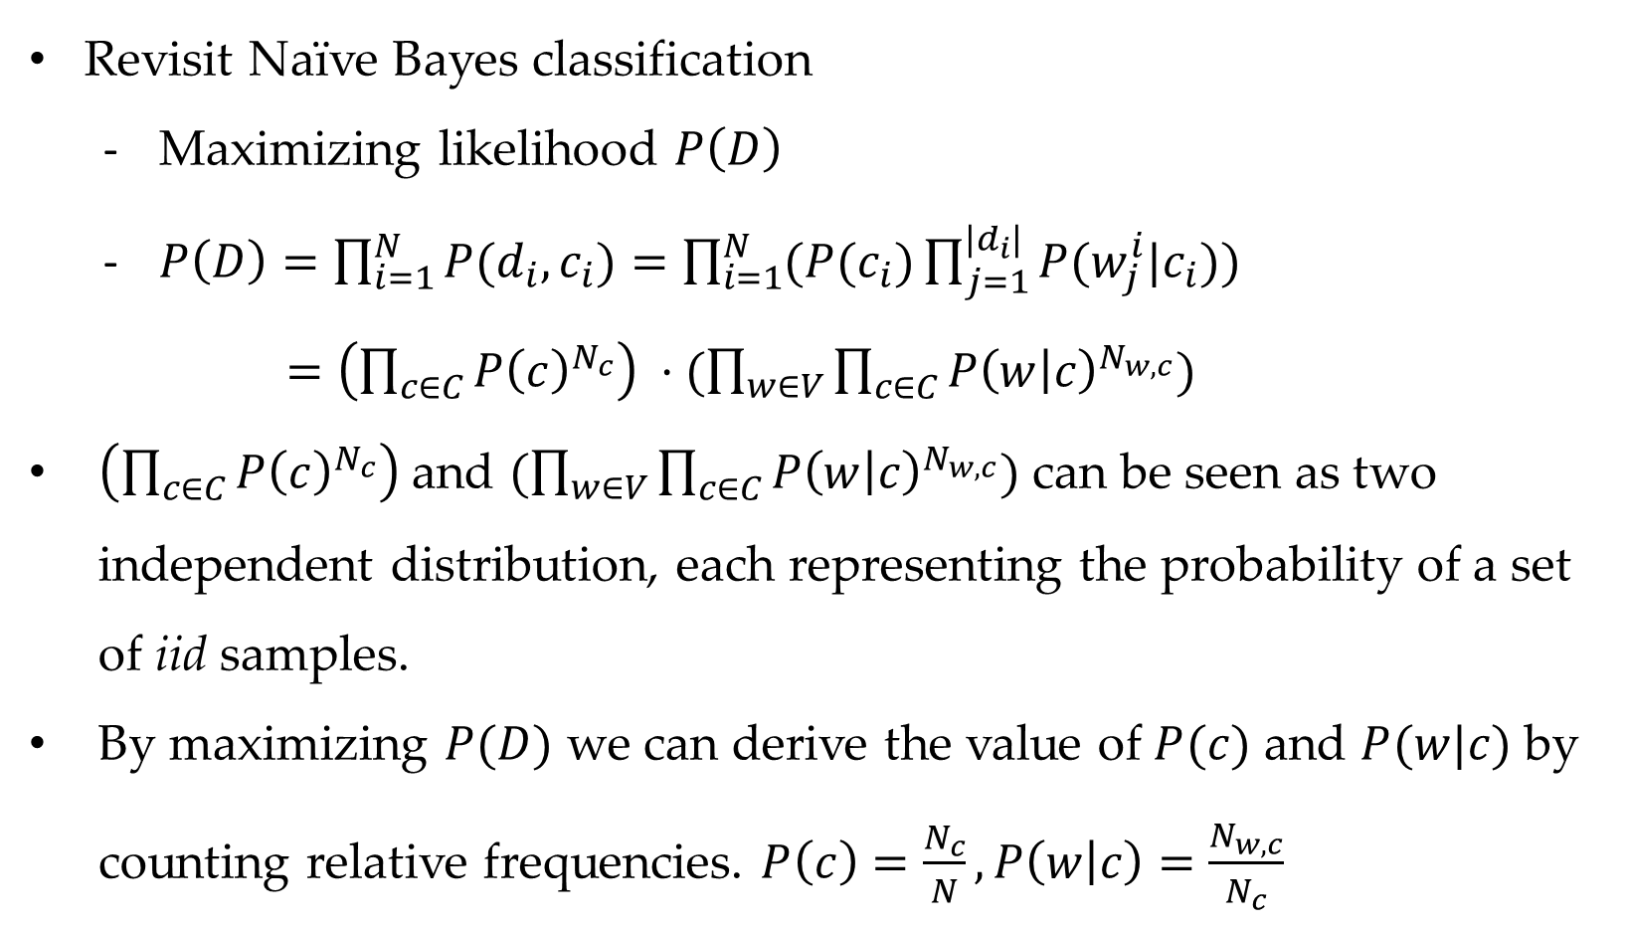
Dealing with Hidden Variables
Revisit Naïve Bayes classification
Maximizing likelihood $P\left(D\right)$
$P\left(D\right)=\prod_{i=1}^{N}{P(d_{i},c_{i})}=\prod_{i=1}^{N}{(P(c_{i})}\prod_{j=1}^{{|d}_{i}|}{P(w_{j}^{i}|c_{i})})$
$=\left(\prod_{c∈C}{P{\left(c\right)}^{N_{c}}}\right) ⋅(\prod_{w∈V}{\prod_{c∈C}{P{\left(w | c\right)}^{N_{w,c}}}})$
$\left(\prod_{c∈C}{P{\left(c\right)}^{N_{c}}}\right)$ and $(\prod_{w∈V}{\prod_{c∈C}{P{\left(w | c\right)}^{N_{w,c}}}})$ can be seen as two independent distribution, each representing the probability of a set of iid samples.
By maximizing $P(D)$ we can derive the value of $P(c)$ and $P(w|c)$ by counting relative frequencies. $P\left(c\right)=\frac{N_{c}}{N}, P\left(w | c\right)=\frac{N_{w,c}}{N_{c}}$
Notes:
P(O,H)

Slide 8
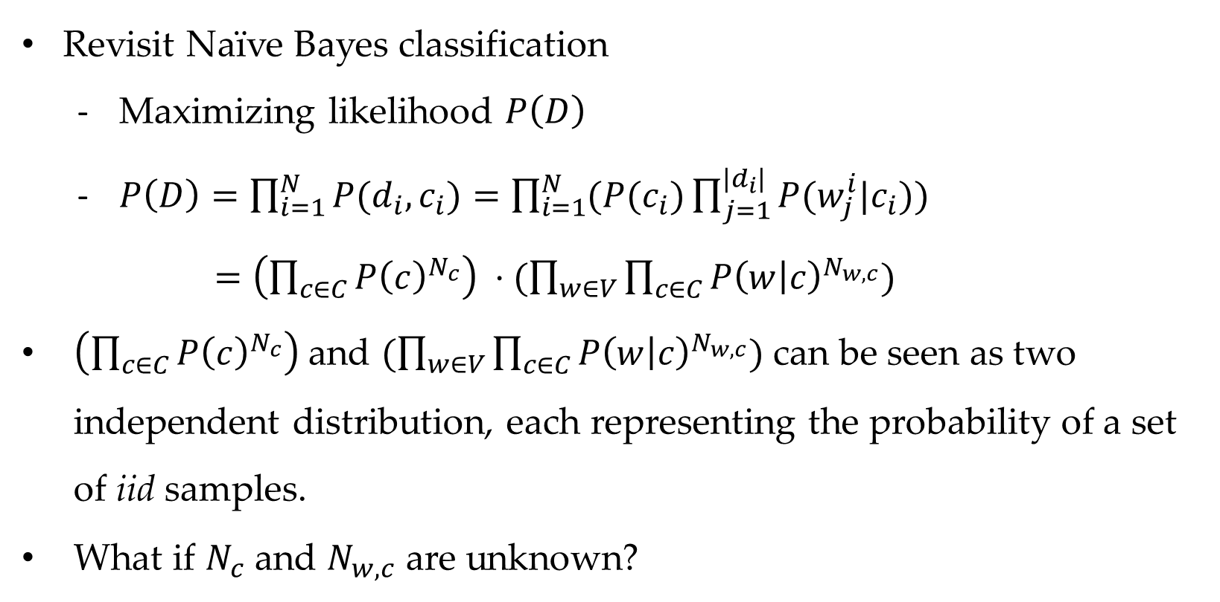
Dealing with Hidden Variables
Revisit Naïve Bayes classification
Maximizing likelihood $P\left(D\right)$
$P\left(D\right)=\prod_{i=1}^{N}{P(d_{i},c_{i})}=\prod_{i=1}^{N}{(P(c_{i})}\prod_{j=1}^{{|d}_{i}|}{P(w_{j}^{i}|c_{i})})$
$=\left(\prod_{c∈C}{P{\left(c\right)}^{N_{c}}}\right) ⋅(\prod_{w∈V}{\prod_{c∈C}{P{\left(w | c\right)}^{N_{w,c}}}})$
$\left(\prod_{c∈C}{P{\left(c\right)}^{N_{c}}}\right)$ and $(\prod_{w∈V}{\prod_{c∈C}{P{\left(w | c\right)}^{N_{w,c}}}})$ can be seen as two independent distribution, each representing the probability of a set of iid samples.
What if $N_{c}$ and $N_{w,c}$ are unknown?
Notes:
P(O,H)

Slide 9
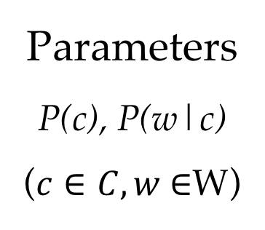
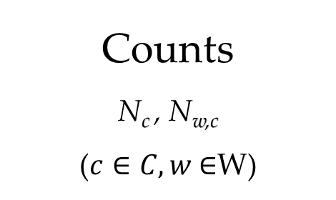
Dealing with Hidden Variables
Counts
N_{c} , N_{w,c}
($c∈C, w$ $∈$W)
Parameters
P(c), P(w|c)
($c∈C, w$ $∈$W)
Hidden variables
c_{i}
(P(c_{i}|d_{i}) )
Observed variables: d_{i}

Slide 10
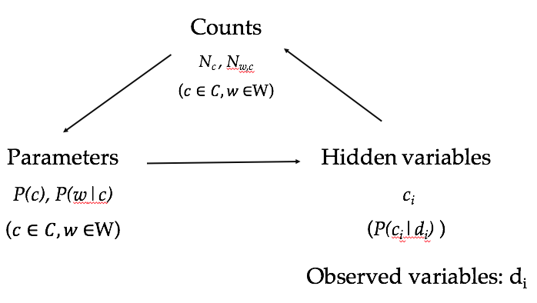
Dealing with Hidden Variables
Iteratively estimate model parameters and hidden variable counts.
Three ways to estimate hidden variable counts
Hard max
Soft probabilities
Sampling

Slide 11
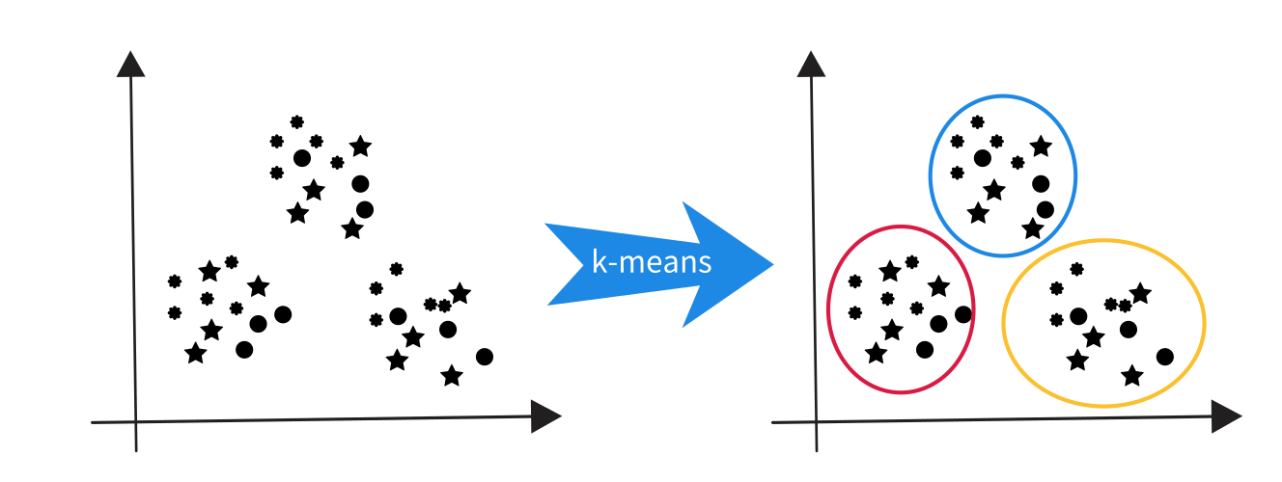

K-means clustering
Observation on K-means clustering
Observed variables: vectors
Hidden variables: cluster assignment
Model parameters: centroids
Initialization: random centroids
Iterative processes:
Hidden variable estimation step:
random point-cluster assignment
Model parameter estimation step:
Centroids are the means

Slide 12
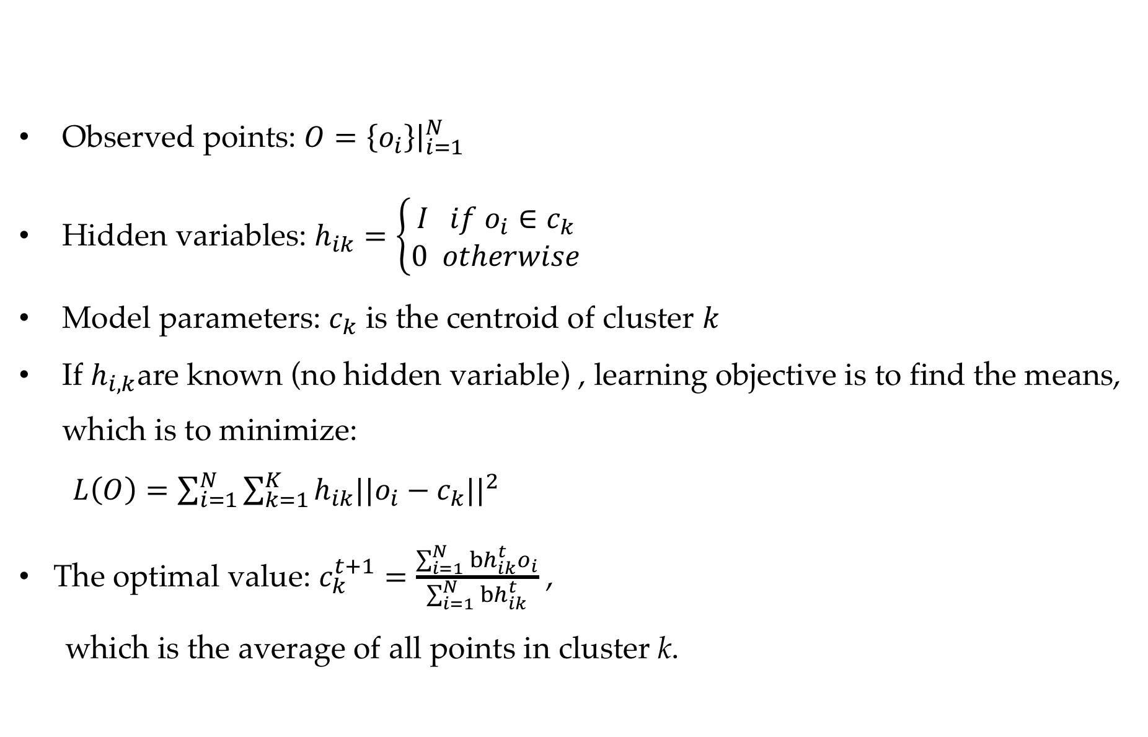
K-means clustering
Observed points: $O={\left.\left\{o_{i}\right\}\right|}_{i=1}^{N}$
Hidden variables: $h_{ik}=\left\{\begin{aligned}I if o_{i}∈c_{k} \\ 0 otherwise\end{aligned}\right.$
Model parameters: $c_{k}$ is the centroid of cluster $k$
If $h_{i,k}$are known (no hidden variable) , learning objective is to find the means, which is to minimize:
$L\left(O\right)=\sum_{i=1}^{N}{\sum_{k=1}^{K}{h_{ik}\left.|{|o}_{i}−c_{k}\right.{||}^{2}}}$
The optimal value: $c_{k}^{t+1}=\frac{\sum_{i=1}^{N}{bh_{ik}^{t}}o_{i}}{\sum_{i=1}^{N}{bh_{ik}^{t}}}$ ,
which is the average of all points in cluster k.

Slide 13
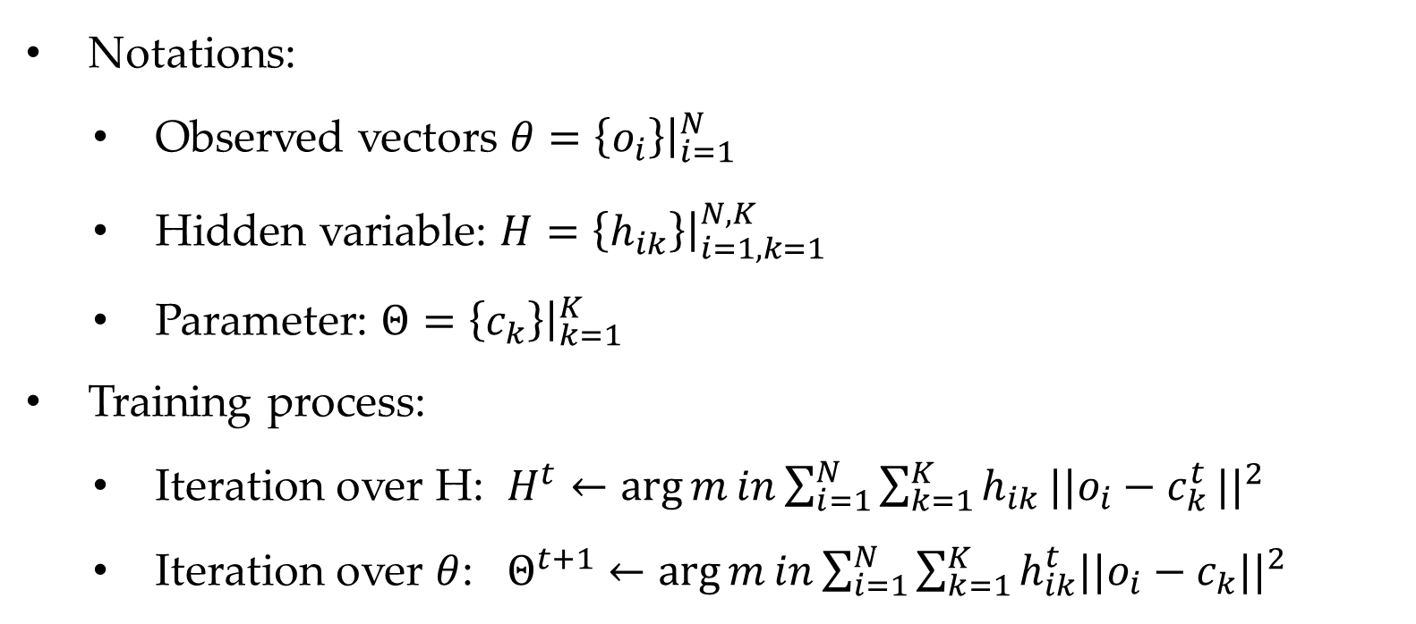
K-means clustering
Notations:
Observed vectors $θ=\left\{o_{i}\right\}{\left.​\right|}_{i=1}^{N}$
Hidden variable: $H={\left.\left\{h_{ik}\right\}\right|}_{i=1,k=1}^{N,K}$
Parameter: $Θ={\left.\left\{c_{k}\right\}\right|}_{k=1}^{K}$
Training process:
Iteration over H: $H^{t}←\arg{m}in\sum_{i=1}^{N}{\sum_{k=1}^{K}{h_{ik}\left.||o_{i}−c_{k}^{t}\right.{||}^{2}}}$
Iteration over $θ$: $Θ^{t+1}←\arg{m}in\sum_{i=1}^{N}{\sum_{k=1}^{K}{h_{ik}^{t}\left.||o_{i}−c_{k}\right.{||}^{2}}}$

Slide 14
Contents
6.1 Expectation Maximization
6.1.1 Introduction
6.1.2 EM
6.1.3 Relationships between MLE and EM
6.2 Using EM
6.2.1 Unsupervised Naïve Bayes model
6.2.2 IBM Model 1
6.2.3 Probabilistic latent semantic analysis
6.2.4 The relative advantages of generative models
6.3 EM theory
6.3.1 EM and KL-Divergence
6.3.2 EM derivation using numerical optimization

Slide 15
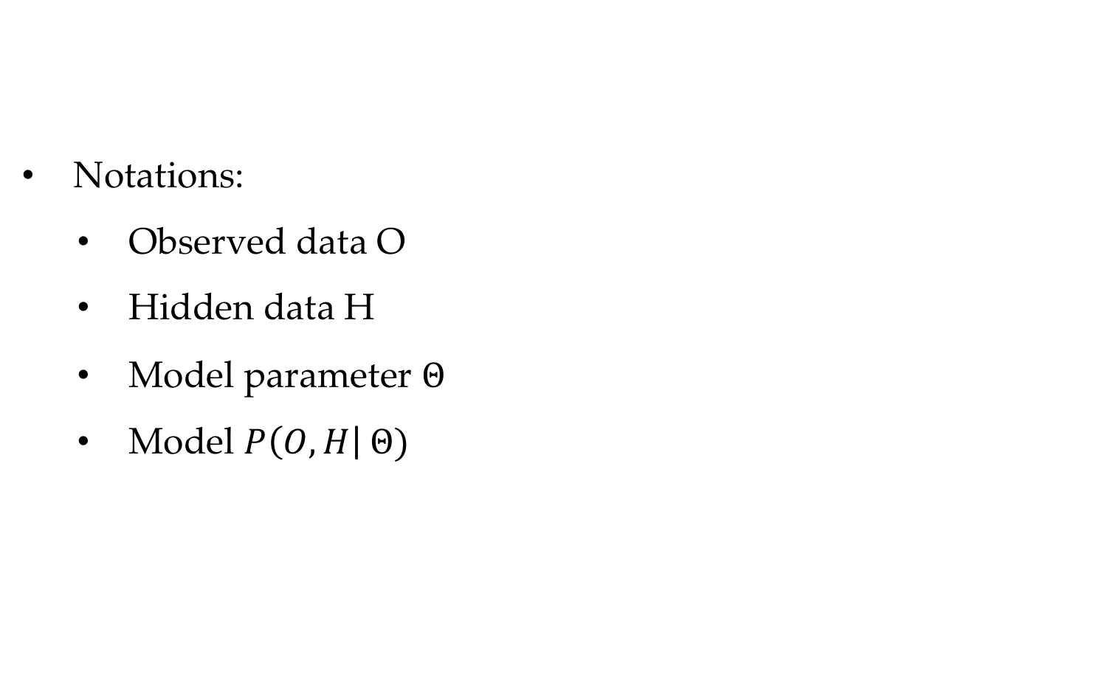
Expectation Maximization Algorithm EM
Notations:
Observed data O
Hidden data H
Model parameter $Θ$
Model $P\left(O,H\right| Θ)$

Slide 16
Two steps for EM
Expectation (E-step)
Estimate hidden variable probabilities.
Maximization (M-step)
Estimate model parameter values.

Slide 17
Dealing with Hidden Variables
Iteratively estimate model parameters and hidden variable counts.
Three ways to estimate hidden variable counts
Hard max
Soft probabilities
Sampling

Slide 18
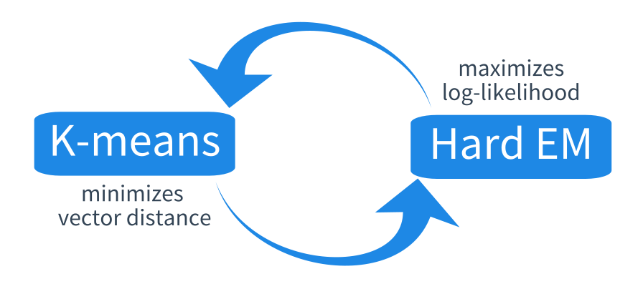
K-means as “Hard” EM
K-means is a type of “hard” EM algorithm.

Slide 19
K-means clustering
Notations:
Observed vectors $θ=\left\{o_{i}\right\}{\left.​\right|}_{i=1}^{N}$
Hidden variable: $H={\left.\left\{h_{ik}\right\}\right|}_{i=1,k=1}^{N,K}$
Parameter: $Θ={\left.\left\{c_{k}\right\}\right|}_{k=1}^{K}$
Training process:
Iteration over H: $H^{t}←\arg{m}in\sum_{i=1}^{N}{\sum_{k=1}^{K}{h_{ik}\left.||o_{i}−c_{k}^{t}\right.{||}^{2}}}$
Iteration over $θ$: $Θ^{t+1}←\arg{m}in\sum_{i=1}^{N}{\sum_{k=1}^{K}{h_{ik}^{t}\left.||o_{i}−c_{k}\right.{||}^{2}}}$

Slide 20
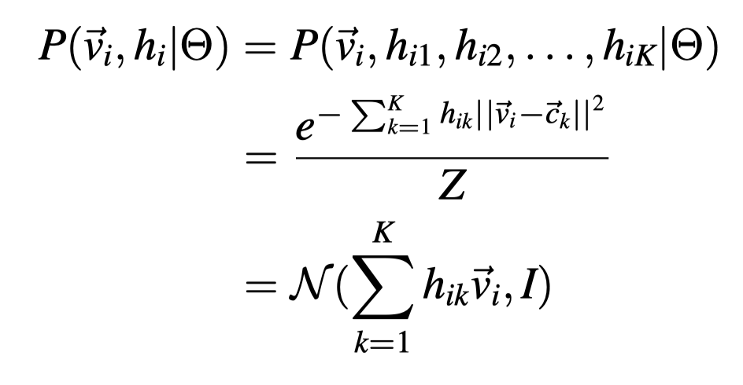
K-means as “Hard” EM
The correlation between minimizing distance and maximizing likelihood:

Slide 21
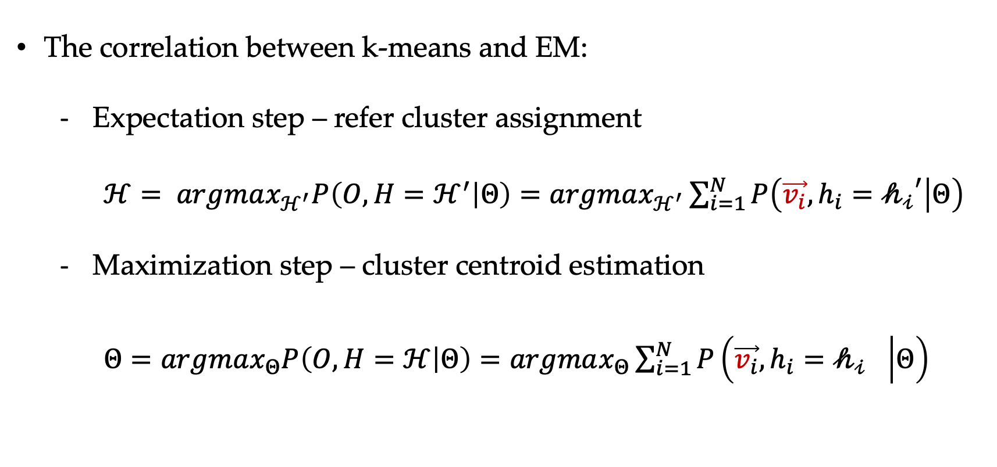
K-means as “Hard” EM
The correlation between k-means and EM:
Expectation step – refer cluster assignment
$ℋ= argmax_{ℋ^{′}}P\left(O,H=ℋ^{′} | Θ\right)=argmax_{ℋ^{′}}\sum_{i=1}^{N}{P\left(\vec{v_{i}},h_{i}={𝒽_{𝒾}}^{′} | Θ\right)}$
Maximization step – cluster centroid estimation
$Θ=argmax_{Θ}P\left(O,H=ℋ | Θ\right)=argmax_{Θ}\sum_{i=1}^{N}{P\left(\vec{v_{i}},h_{i}={𝒽_{𝒾}}^{} | Θ\right)}$

Slide 22
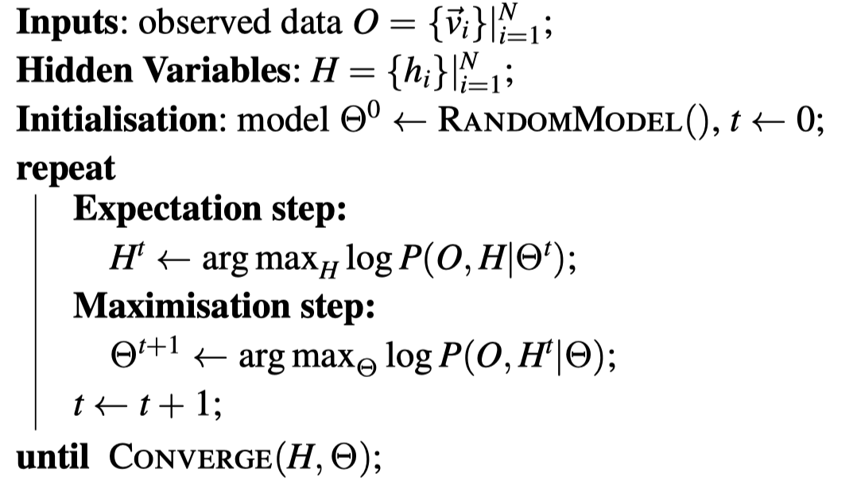
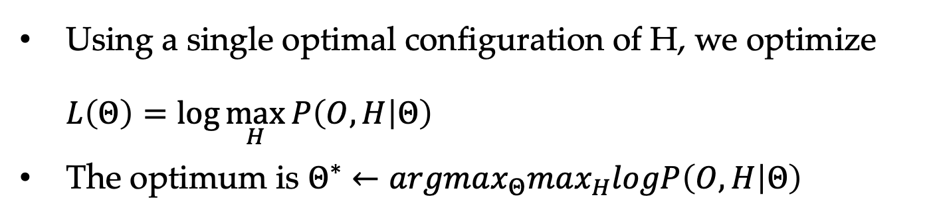
K-means as “Hard” EM
Using a single optimal configuration of H, we optimize $L\left(Θ\right)=\log{\max_{H}{P\left(O,H | Θ\right)}}$
The optimum is $Θ^{∗}←argmax_{Θ}max_{H}logP\left(O,H | Θ\right)$

Slide 23
Contents
6.1 Expectation Maximization
6.1.1 Introduction
6.1.2 EM
6.1.3 Relationships between MLE and EM
6.2 Using EM
6.2.1 Unsupervised Naïve Bayes model
6.2.2 IBM Model 1
6.2.3 Probabilistic latent semantic analysis
6.2.4 The relative advantages of generative models
6.3 EM theory
6.3.1 EM and KL-Divergence
6.3.2 EM derivation using numerical optimization

Slide 24
Dealing with Hidden Variables
Iteratively estimate model parameters and hidden variable counts.
Three ways to estimate hidden variable counts
Hard max
Soft probabilities
Sampling

Slide 25
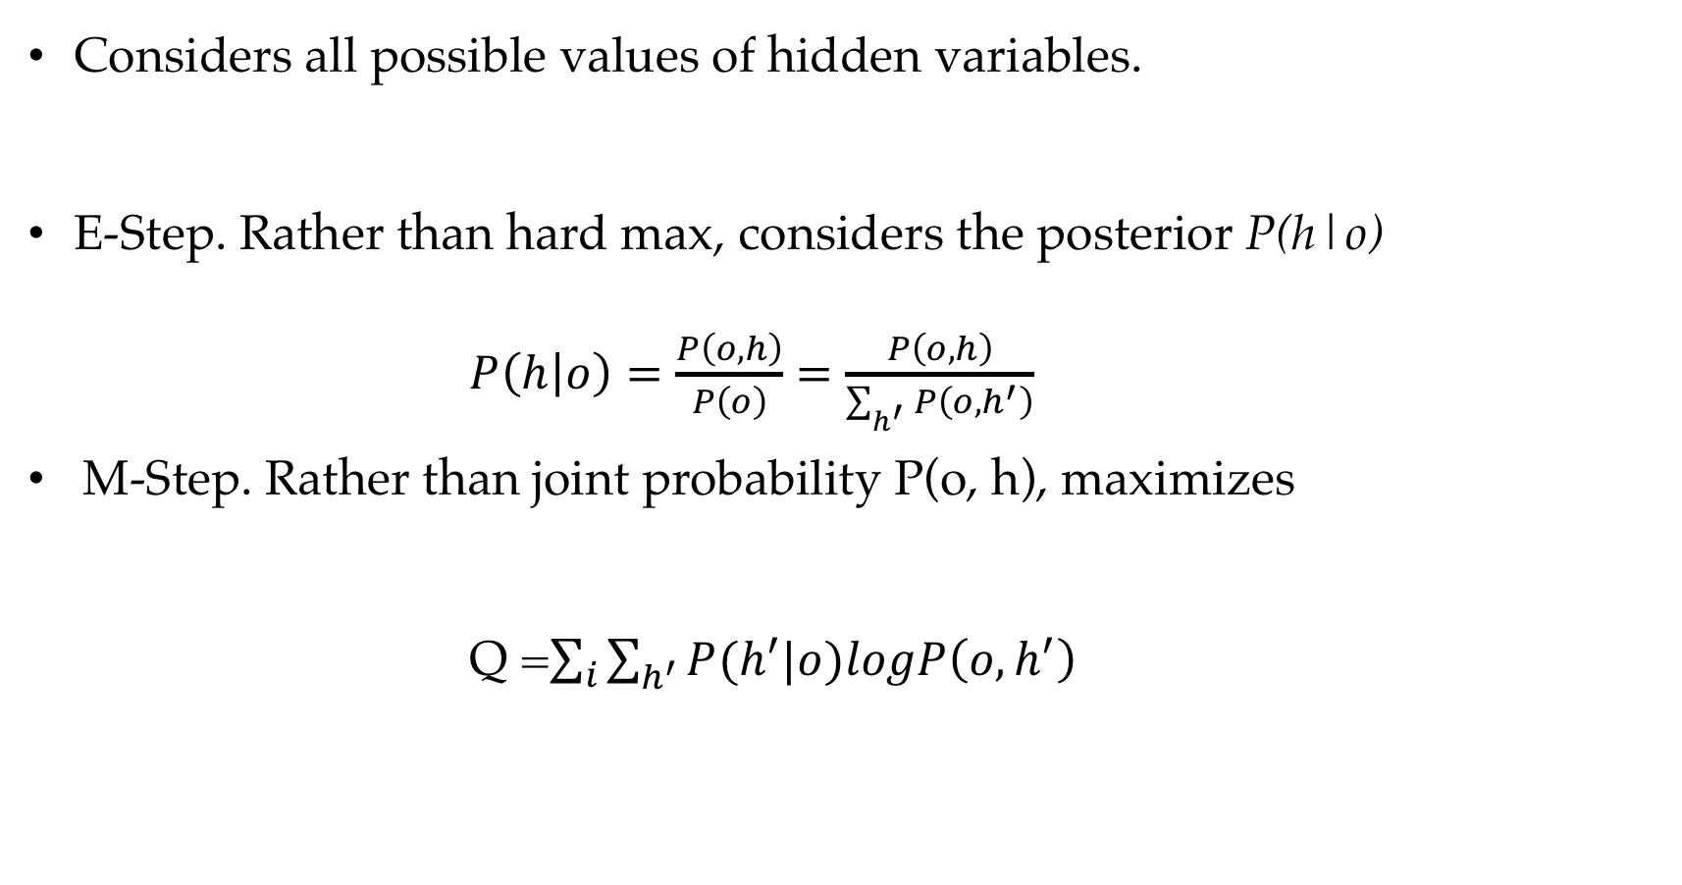
EM
Considers all possible values of hidden variables.
E-Step. Rather than hard max, considers the posterior P(h|o) $P\left(h | o\right)=\frac{P\left(o,h\right)}{P\left(o\right)}=\frac{P\left(o,h\right)}{\sum_{h^{′}}{P\left(o, h^{′}\right)}}$
M-Step. Rather than joint probability P(o, h), maximizes Q =$\sum_{i}{\sum_{h^{′}}{P(h^{′}|o)logP\left(o, h^{′}\right)}}$

Slide 26
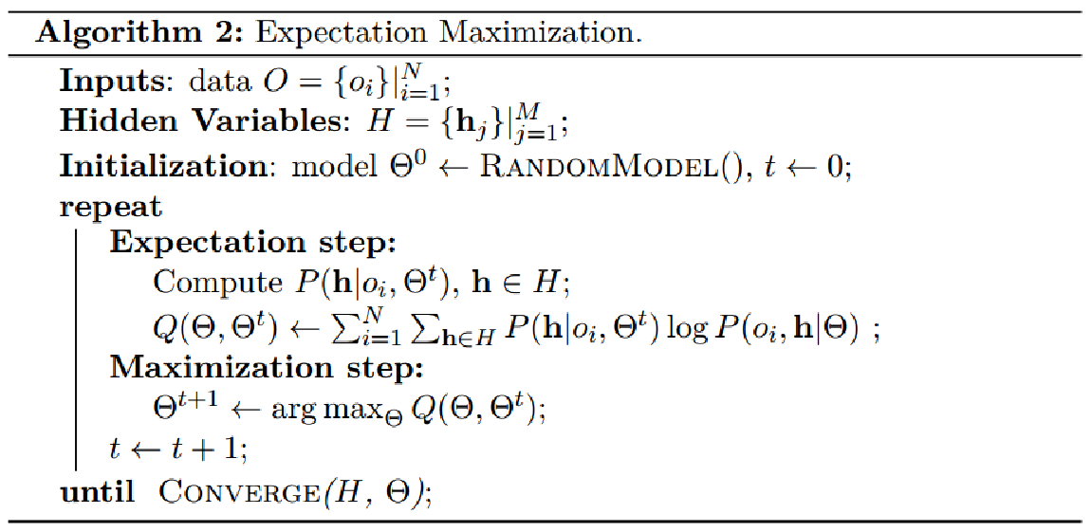
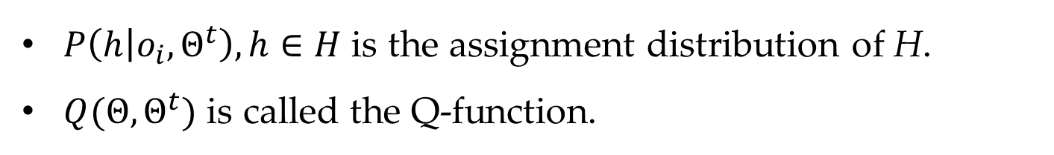
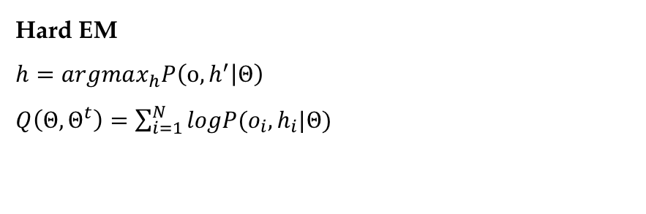
EM
EM considers all possible values of hidden variables.
Hard EM
$$h=argmax_{h}P\left({o, h}^{′} | Θ\right)$$
$Q\left(Θ,Θ^{t}\right)=\sum_{i=1}^{N}{logP(o_{i},h_{i}|Θ)}$
$P\left(h | o_{i},Θ^{t}\right),h∈H$ is the assignment distribution of H.
$Q(Θ,Θ^{t})$ is called the Q-function.

Slide 27
Contents
6.1 Expectation Maximization
6.1.1 Introduction
6.1.2 EM
6.1.3 Relationships between MLE and EM
6.2 Using EM
6.2.1 Unsupervised Naïve Bayes model
6.2.2 IBM Model 1
6.2.3 Probabilistic latent semantic analysis
6.2.4 The relative advantages of generative models
6.3 EM theory
6.3.1 EM and KL-Divergence
6.3.2 EM derivation using numerical optimization

Slide 28
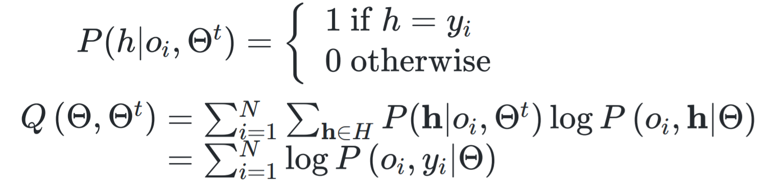
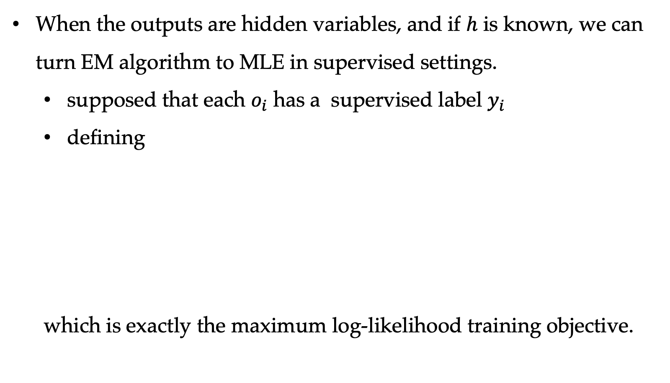
Relationships between MLE and Q-function
When the outputs are hidden variables, and if $h$ is known, we can turn EM algorithm to MLE in supervised settings.
supposed that each $o_{i}$ has a supervised label $y_{i}$
defining
which is exactly the maximum log-likelihood training objective.

Slide 29
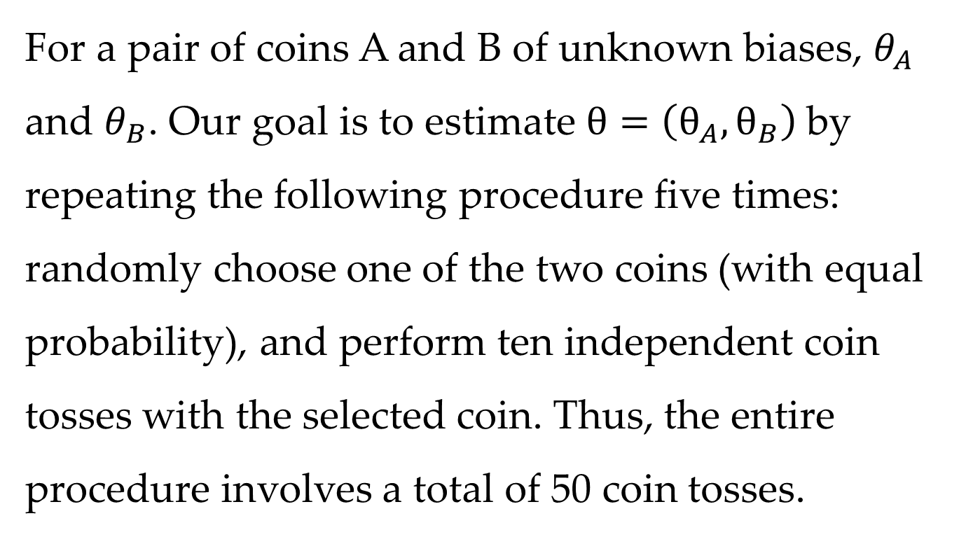
Case study
A coin-flipping experiment
For a pair of coins A and B of unknown biases, $θ_{A}$ and $θ_{B}$. Our goal is to estimate $θ=\left(θ_{A},θ_{B}\right)$by repeating the following procedure five times: randomly choose one of the two coins (with equal probability), and perform ten independent coin tosses with the selected coin. Thus, the entire procedure involves a total of 50 coin tosses.

Slide 30
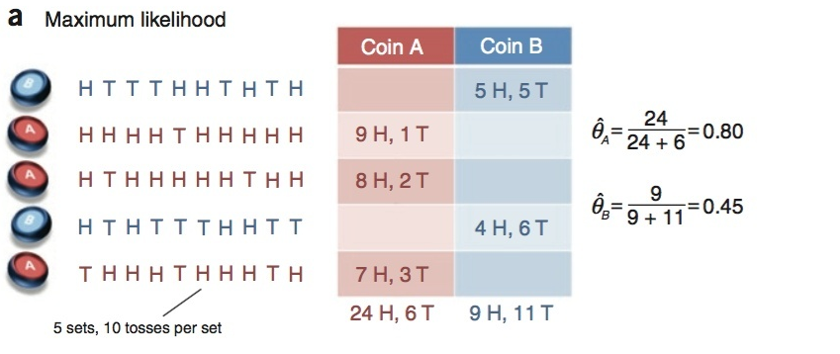
Case 1
Parameter estimation in this setting is known as the complete data case in that the values of all relevant random variables in our model (that is, the result of each coin flip and the type of coin used for each flip) are known.
Problem set originated from Chuong B Do & Serafim Batzoglou

Slide 31
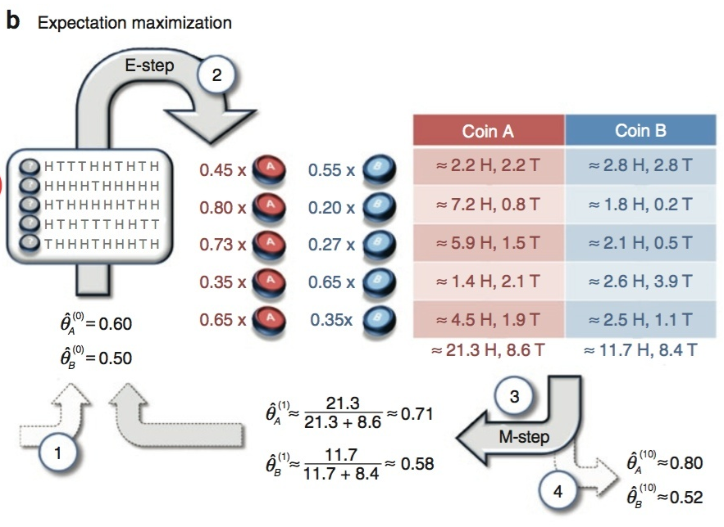
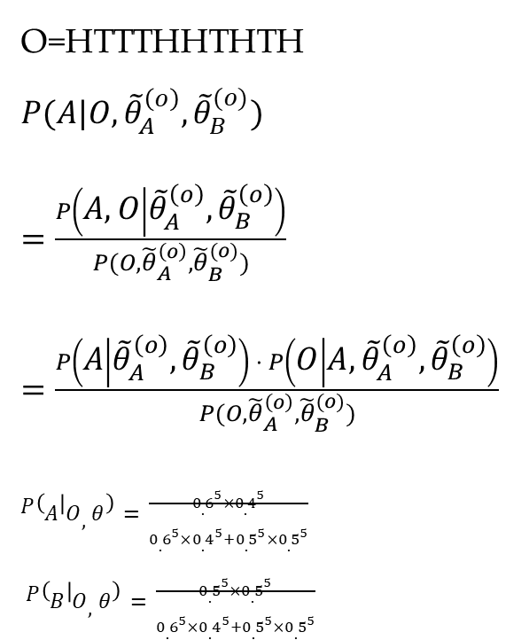
Case 2
Now consider a more challenging variant of the parameter estimation problem in which we are given the recorded head counts but not the identities of the coins used for each set of tosses.
O=HTTTHHTHTH
$P(A|O,{\tilde{θ}}_{A}^{\left(o\right)},{\tilde{θ}}_{B}^{(o)})$
$=\frac{P\left(A,O | {\tilde{θ}}_{A}^{\left(o\right)},{\tilde{θ}}_{B}^{\left(o\right)}\right)}{P(O,{\tilde{θ}}_{A}^{\left(o\right)},{\tilde{θ}}_{B}^{(o)})}$
$=\frac{P\left(A | {\tilde{θ}}_{A}^{\left(o\right)},{\tilde{θ}}_{B}^{\left(o\right)}\right) ⋅ P\left(O | A,{\tilde{θ}}_{A}^{\left(o\right)},{\tilde{θ}}_{B}^{\left(o\right)}\right)}{P(O,{\tilde{θ}}_{A}^{\left(o\right)},{\tilde{θ}}_{B}^{(o)})}$
$P\left(A | O,θ\right)=\frac{{0.6}^{5}×{0.4}^{5}}{{0.6}^{5}×{0.4}^{5}+{0.5}^{5}×{0.5}^{5}}$
$P\left(B | O,θ\right)=\frac{{0.5}^{5}×{0.5}^{5}}{{0.6}^{5}×{0.4}^{5}+{0.5}^{5}×{0.5}^{5}}$

Slide 32
Contents
6.1 Expectation Maximization
6.1.1 Introduction
6.1.2 EM
6.1.3 Relationships between MLE and EM
6.2 Using EM
6.2.1 Unsupervised Naïve Bayes model
6.2.2 IBM Model 1
6.2.3 Probabilistic latent semantic analysis
6.2.4 The relative advantages of generative models
6.3 EM theory
6.3.1 EM and KL-Divergence
6.3.2 EM derivation using numerical optimization

Slide 33
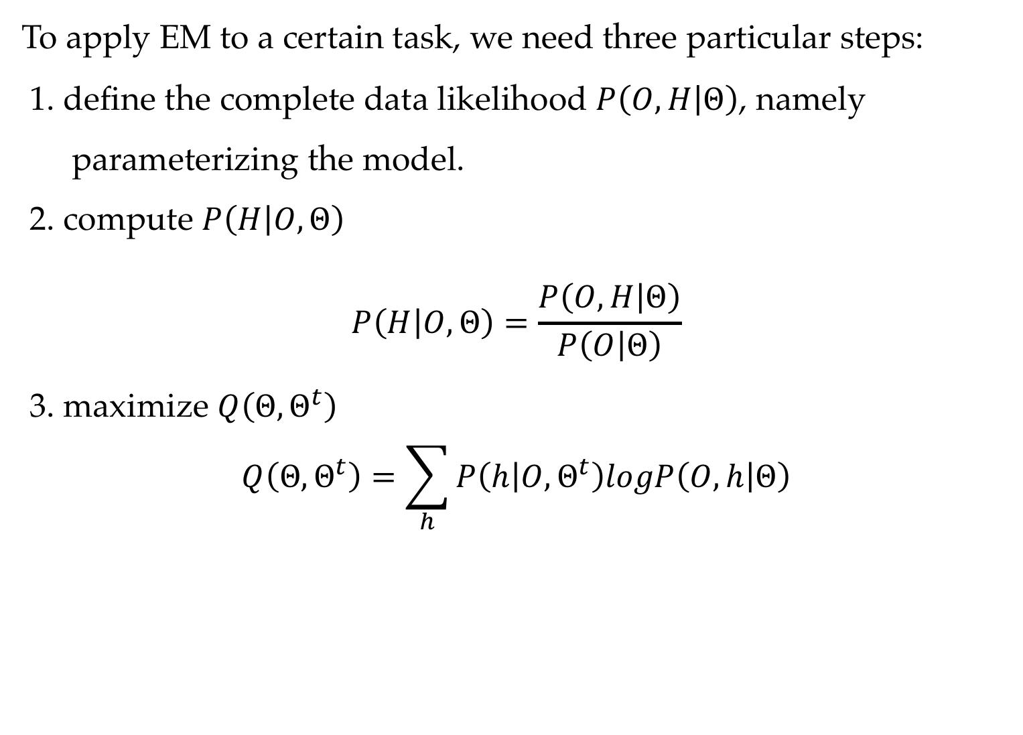
EM algorithm summary
To apply EM to a certain task, we need three particular steps:
1. define the complete data likelihood $P\left(O,H | Θ\right)$, namely parameterizing the model.
2. compute $P\left(H | O,Θ\right)$ $$P\left(H | O,Θ\right)=\frac{P\left(O,H | Θ\right)}{P\left(O | Θ\right)}$$
3. maximize $Q\left(Θ,Θ^{t}\right)$
$$Q\left(Θ,Θ^{t}\right)=\sum_{h}{P\left(h | O,Θ^{t}\right)logP\left(O,h | Θ\right)}$$

Slide 34
Contents
6.1 Expectation Maximization
6.1.1 Introduction
6.1.2 EM
6.1.3 Relationships between MLE and EM
6.2 Using EM
6.2.1 Unsupervised Naïve Bayes model
6.2.2 IBM Model 1
6.2.3 Probabilistic latent semantic analysis
6.2.4 The relative advantages of generative models
6.3 EM theory
6.3.1 EM and KL-Divergence
6.3.2 EM derivation using numerical optimization

Slide 35
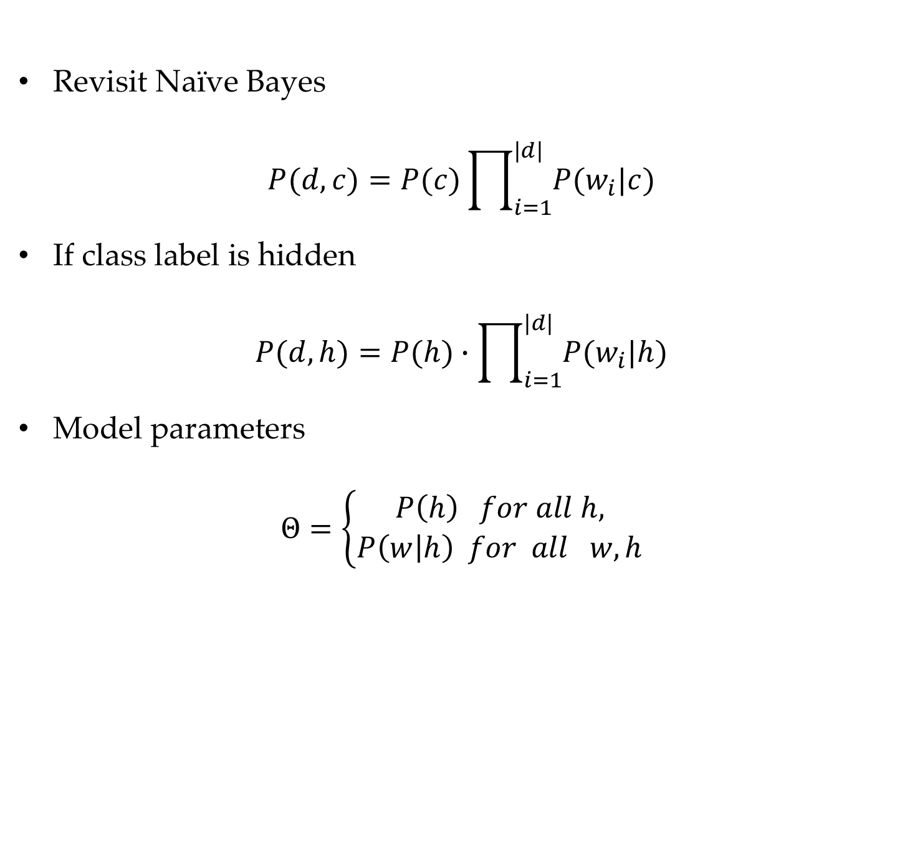
Unsupervised Naïve Bayes model
Revisit Naïve Bayes
$$P(d,c)=P(c)\prod_{i=1}^{|d|}{P(w_{i}|c)}$$
If class label is hidden
$$P(d,h)=P(h)∙\prod_{i=1}^{|d|}{P(w_{i}|h)}$$
Model parameters
$$Θ=\left\{\begin{aligned}P\left(h\right) for all h, \\ P\left(w | h\right) for all w, h\end{aligned}\right.$$

Slide 36
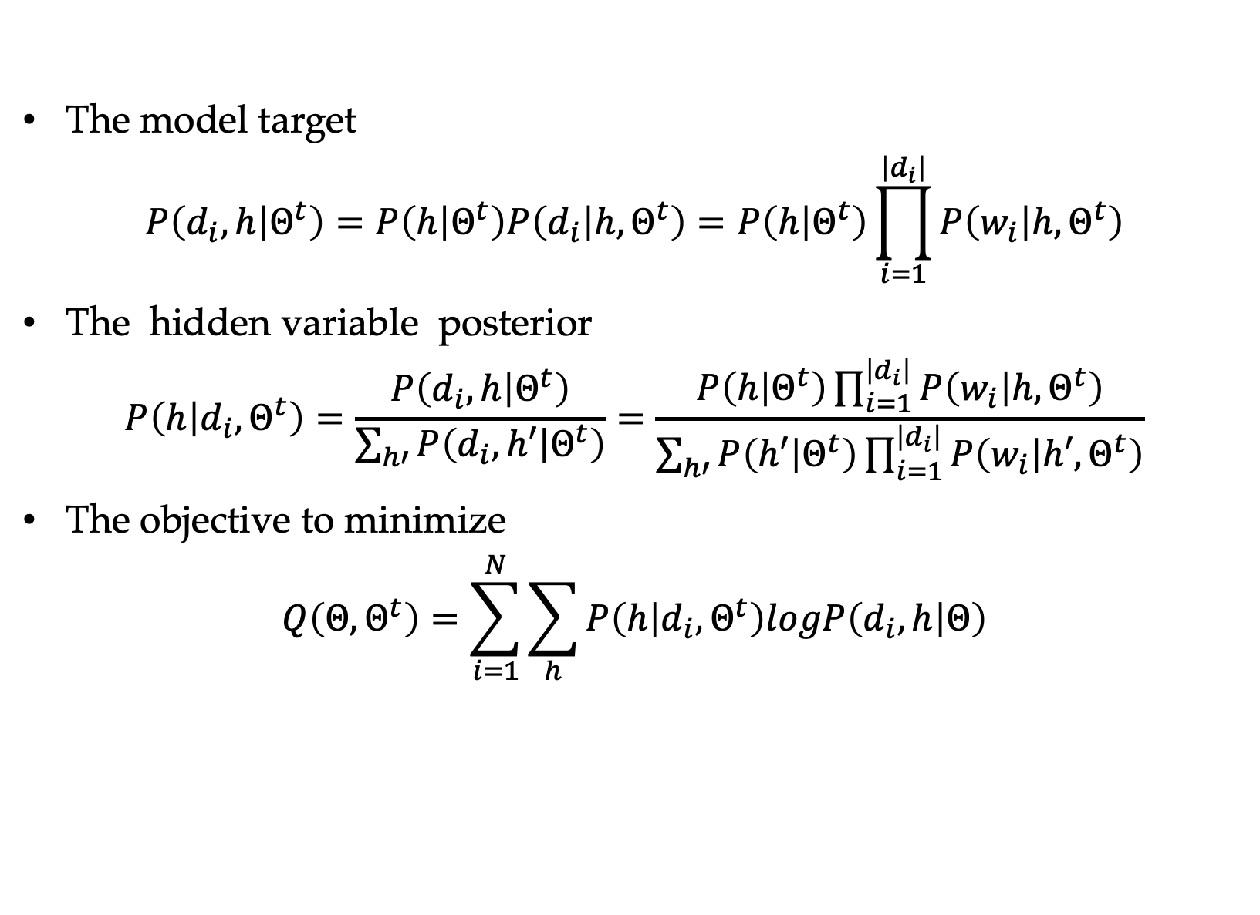
Unsupervised Naïve Bayes model
The model target
$$P\left(d_{i},h | Θ^{t}\right)=P\left(h | Θ^{t}\right)P\left(d_{i} | h,Θ^{t}\right)=P\left(h | Θ^{t}\right)\prod_{i=1}^{\left|d_{i}\right|}{P\left(w_{i} | h,Θ^{t}\right)}$$
The hidden variable posterior
$$P\left(h | d_{i},Θ^{t}\right)=\frac{P\left(d_{i},h | Θ^{t}\right)}{\sum_{h′}{P\left(d_{i},h′ | Θ^{t}\right)}}=\frac{P\left(h | Θ^{t}\right)\prod_{i=1}^{\left|d_{i}\right|}{P\left(w_{i} | h,Θ^{t}\right)}}{\sum_{h′}{P\left(h′ | Θ^{t}\right)\prod_{i=1}^{\left|d_{i}\right|}{P\left(w_{i} | h′,Θ^{t}\right)}}}$$
The objective to minimize
$$Q\left(Θ,Θ^{t}\right)=\sum_{i=1}^{N}{\sum_{h}{P\left(h | d_{i},Θ^{t}\right)logP\left(d_{i},h | Θ\right)}}$$

Slide 37
Unsupervised Naïve Bayes model

Slide 38
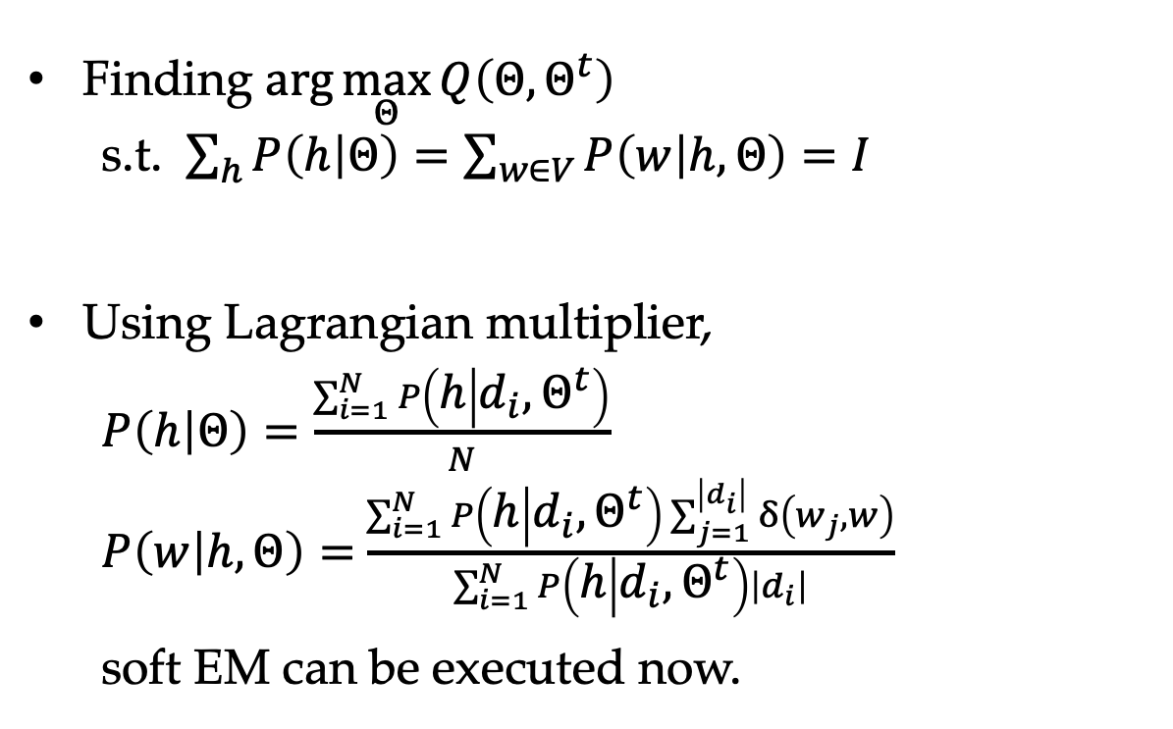
Unsupervised Naïve Bayes model
Finding $\arg{\max_{Θ}{Q\left(Θ,Θ^{t}\right)}}$
s.t. $\sum_{h}{P\left(h | Θ\right)}=\sum_{w∈V}{P\left(w | h,Θ\right)}=I$
Using Lagrangian multiplier,
$P\left(h | Θ\right)=\frac{\sum_{i=1}^{N}{P\left(h | d_{i},Θ^{t}\right)}}{N}$
$P\left(w | h,Θ\right)=$ $\frac{\sum_{i=1}^{N}{P\left(h | d_{i},Θ^{t}\right)\sum_{j=1}^{\left|d_{i}\right|}{δ\left(w_{j},w\right)}}}{\sum_{i=1}^{N}{P\left(h | d_{i},Θ^{t}\right)\left|d_{i}\right|}}$
soft EM can be executed now.

Slide 39
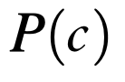
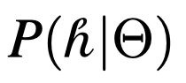
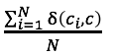
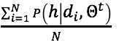
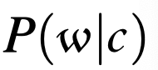
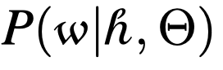
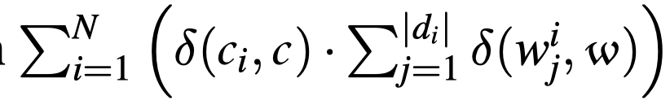
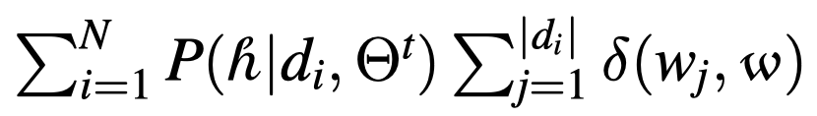
Comparison between related models
Unsupervised Naïve Bayes vs Naïve Bayes

Slide 40
Comparison between related models
Unsupervised Naïve Bayes vs k-means
K-means is based on vector space geometry, while Naïve Bayes is direct probability model.
Naïve Bayes is optimized with EM, while k-means is a hard variant of EM.

Slide 41
Contents
6.1 Expectation Maximization
6.1.1 Introduction
6.1.2 EM
6.1.3 Relationships between MLE and EM
6.2 Using EM
6.2.1 Unsupervised Naïve Bayes model
6.2.2 IBM Model 1
6.2.3 Probabilistic latent semantic analysis
6.2.4 The relative advantages of generative models
6.3 EM theory
6.3.1 EM and KL-Divergence
6.3.2 EM derivation using numerical optimization

Slide 42
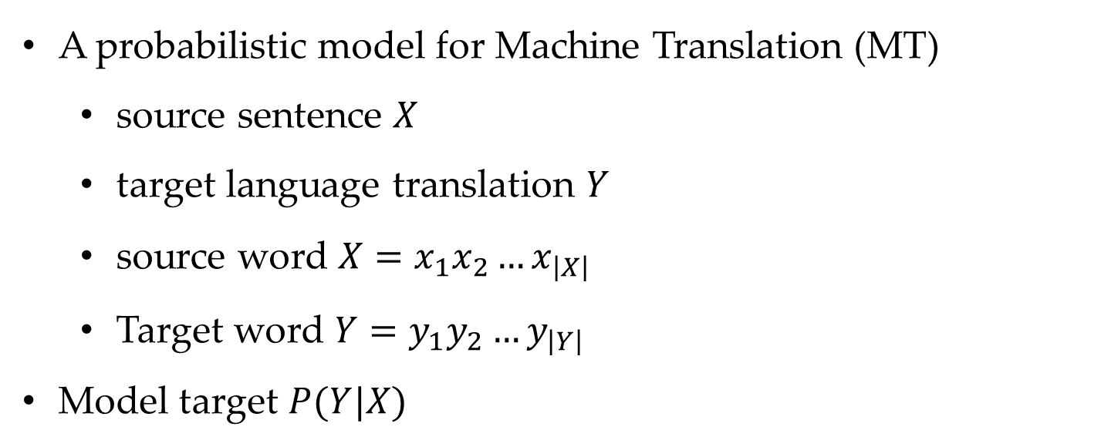
IBM Model 1
A probabilistic model for Machine Translation (MT)
source sentence $X$
target language translation $Y$
source word $X=x_{1}x_{2}…x_{\left|X\right|}$
Target word $Y=y_{1}y_{2}…y_{\left|Y\right|}$
Model target $P(Y|X)$

Slide 43
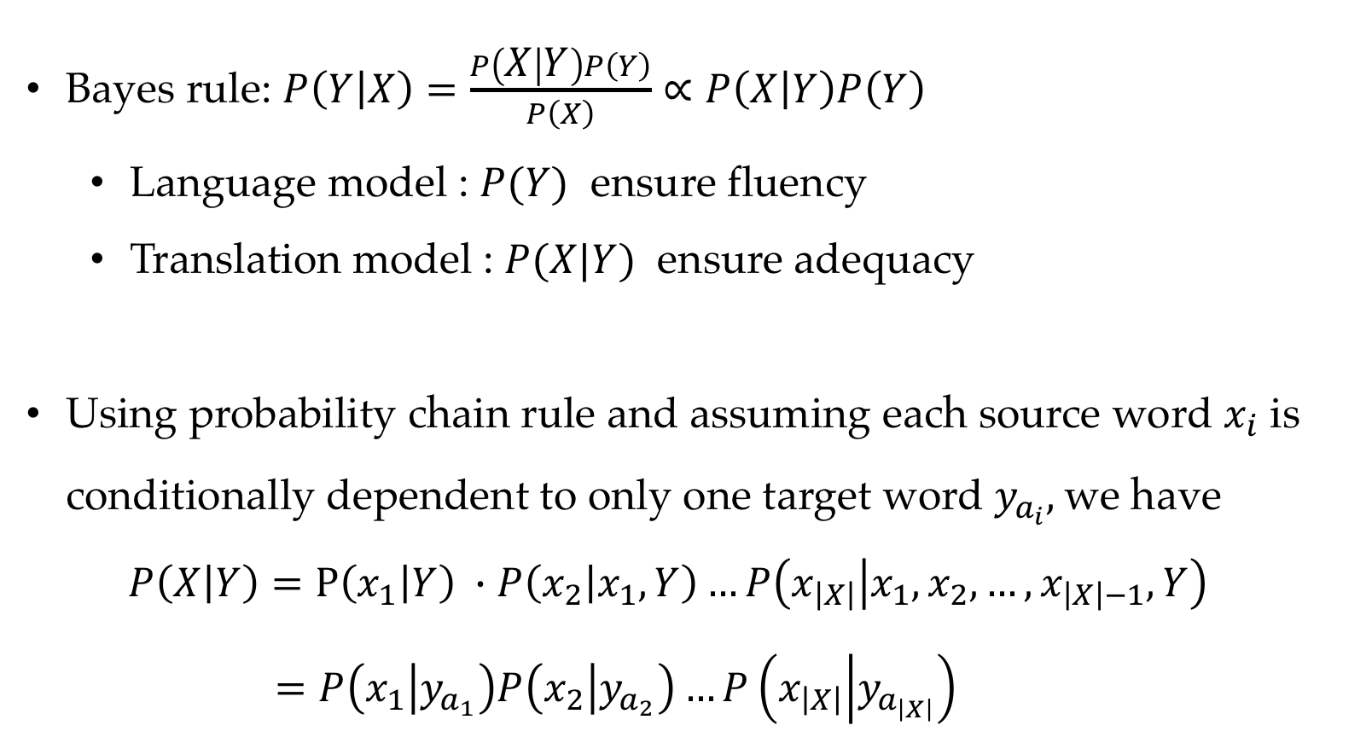
IBM Model 1
Bayes rule: $P\left(Y | X\right)=\frac{P\left(X | Y\right)P\left(Y\right)}{P\left(X\right)}∝P\left(X | Y\right)P\left(Y\right)$
Language model : $P(Y)$ ensure fluency
Translation model : $P(X|Y)$ ensure adequacy
Using probability chain rule and assuming each source word $x_{i}$ is conditionally dependent to only one target word $y_{a_{i}},$we have
$P\left(X | Y\right)=P\left(x_{1} | Y\right) ∙P\left(x_{2} | x_{1},Y\right)…P\left(x_{\left|X\right|} | x_{1}, x_{2},…,x_{\left|X\right|−1},Y\right)$
$=P\left(x_{1} | y_{a_{1}}\right)P\left(x_{2} | y_{a_{2}}\right)…P\left(x_{\left|X\right|} | y_{a_{\left|X\right|}}\right)$

Slide 44
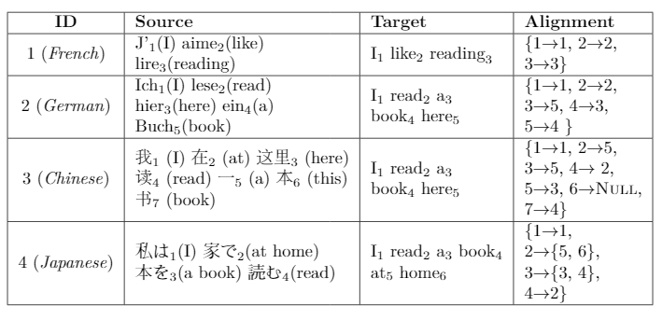
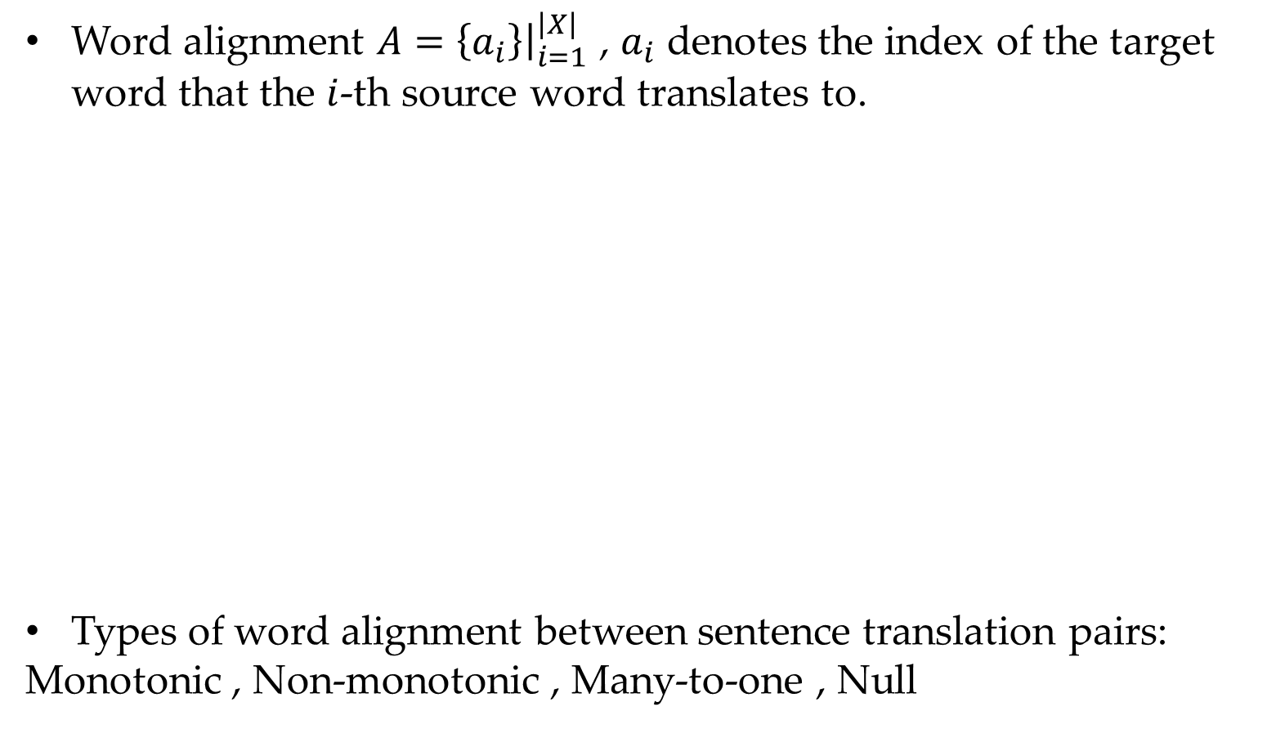
Word alignment
Word alignment $A={\left.\left\{a_{i}\right\}\right|}_{i=1}^{\left|X\right|}$ , $a_{i}$ denotes the index of the target word that the $i$-th source word translates to.
Types of word alignment between sentence translation pairs:
Monotonic , Non-monotonic , Many-to-one , Null

Slide 45
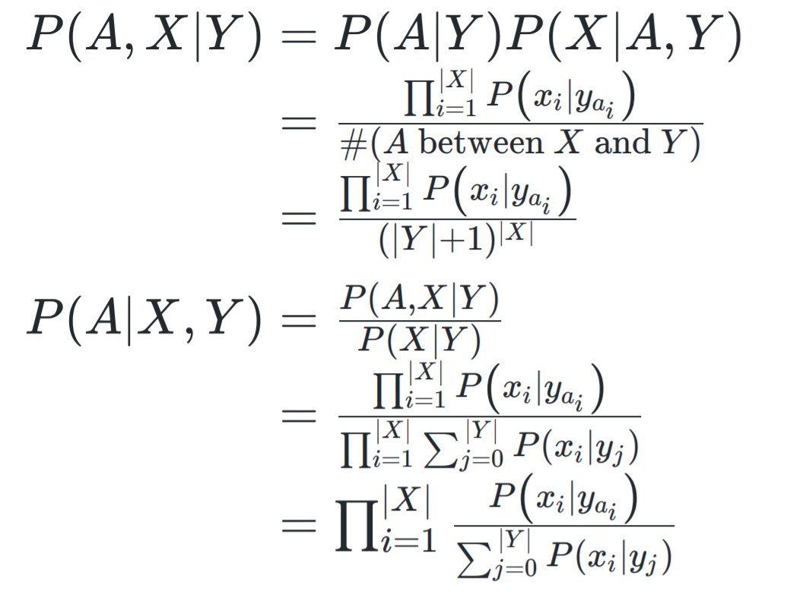
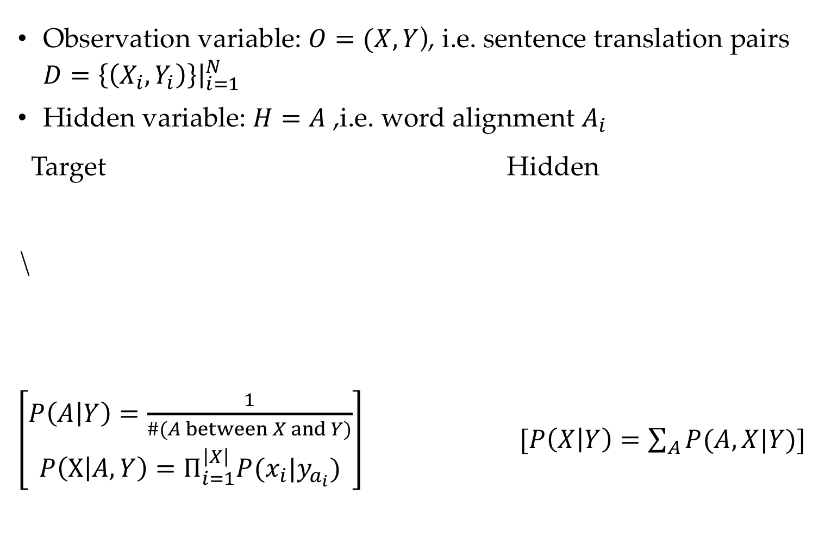
EM training
Observation variable: $O=(X,Y$), i.e. sentence translation pairs $D={\left.\left\{\left(X_{i},Y_{i}\right)\right\}\right|}_{i=1}^{N}$
Hidden variable: $H=A$ ,i.e. word alignment $A_{i}$
Target Hidden
\
$\left[\begin{aligned}P\left(A | Y\right)=\frac{1}{\#(A between X and Y)} \\ P\left(X | A,Y\right)=Π_{i=1}^{\left|X\right|}P(x_{i}|y_{a_{i}})\end{aligned}\right]$ $[P\left(X | Y\right)=\sum_{A}{P(A,X|Y)}]$

Slide 46
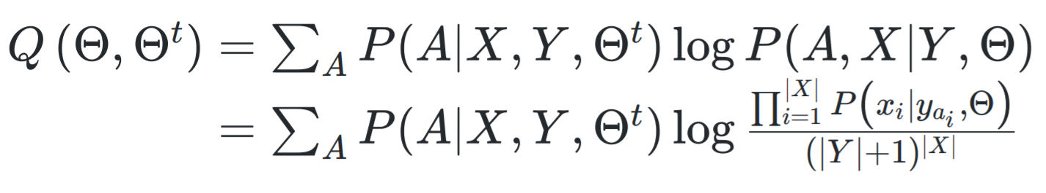
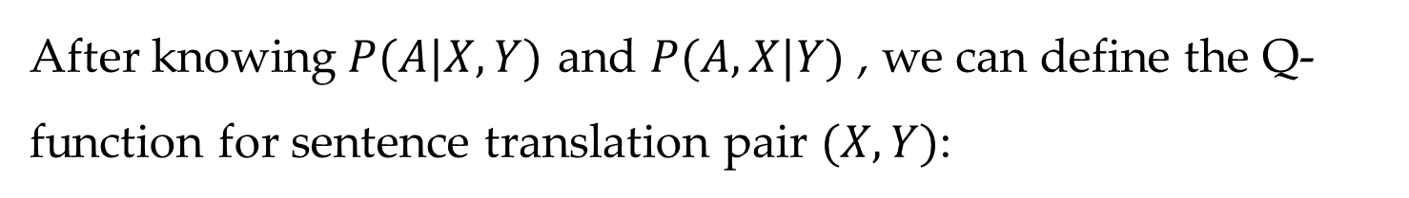
EM training
After knowing$P(A|X,Y)$ and $P(A,X|Y)$ , we can define the Q-function for sentence translation pair $(X,Y)$:

Slide 47
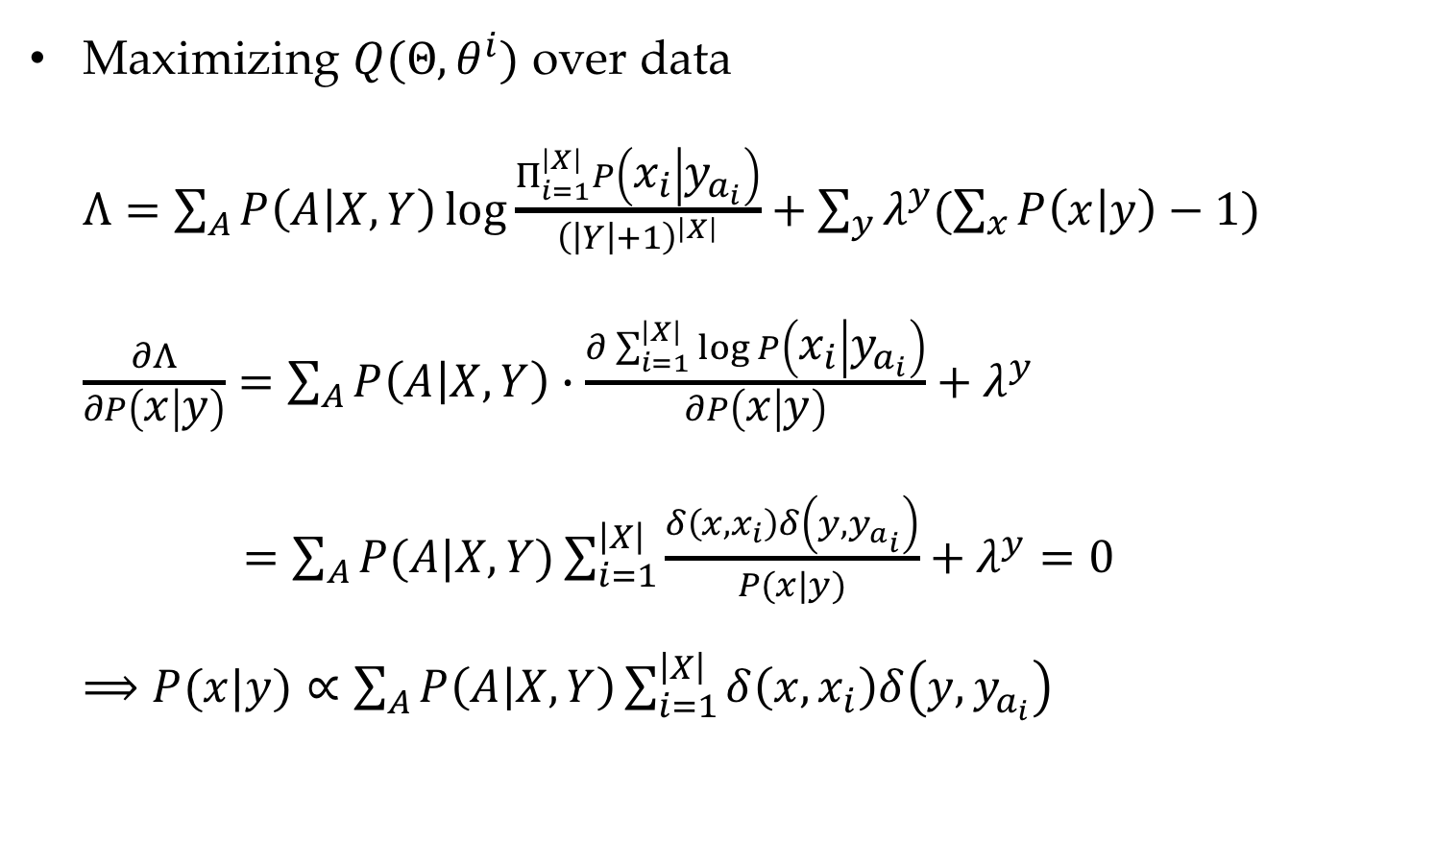
EM training
Maximizing $Q(Θ,θ^{i})$ over data
$Λ=\sum_{A}{P\left(A | X,Y\right)\log{\frac{Π_{i=1}^{\left|X\right|}P\left(x_{i} | y_{a_{i}}\right)}{{\left(\left|Y\right|+1\right)}^{\left|X\right|}}}+\sum_{y}{λ^{y}(\sum_{x}{P\left(x | y\right)−1})}}$
$\frac{∂Λ}{∂P\left(x | y\right)}=\sum_{A}{P\left(A | X,Y\right)∙\frac{∂\sum_{i=1}^{\left|X\right|}{\log{P\left(x_{i} | y_{a_{i}}\right)}}}{∂P\left(x | y\right)}+λ^{y}}$
$=\sum_{A}{P(A|X,Y)}\sum_{i=1}^{\left|X\right|}{\frac{δ\left(x,x_{i}\right)δ\left(y,y_{a_{i}}\right)}{P(x|y)}}+λ^{y}=0$
$⟹P(x|y)∝\sum_{A}{P\left(A | X,Y\right)\sum_{i=1}^{\left|X\right|}{δ\left(x,x_{i}\right)δ\left(y,y_{a_{i}}\right)}}$

Slide 48
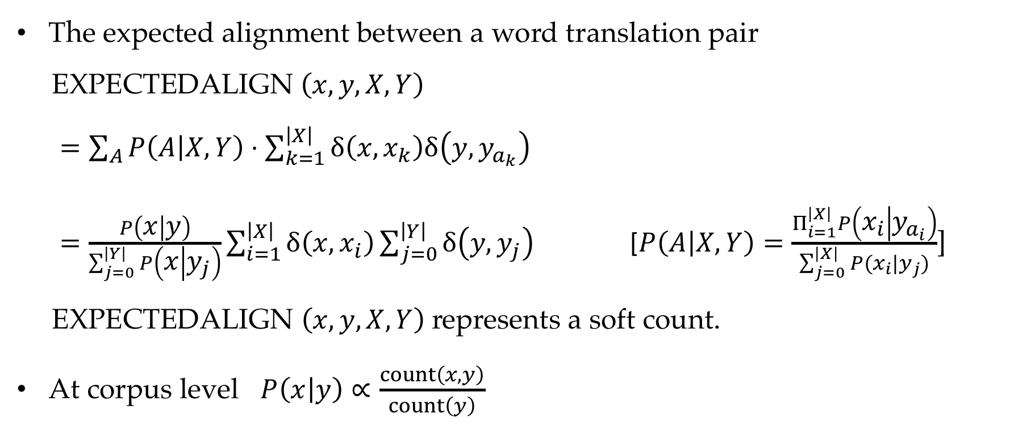
EM training
The expected alignment between a word translation pair
EXPECTEDALIGN $\left(x,y,X,Y\right)$
$=\sum_{A}{P\left(A | X,Y\right)}⋅\sum_{k=1}^{\left|X\right|}{δ\left(x,x_{k}\right)δ\left(y,y_{a_{k}}\right)}$
$=\frac{P\left(x | y\right)}{\sum_{j=0}^{\left|Y\right|}{P\left(x | y_{j}\right)}}\sum_{i=1}^{\left|X\right|}{δ\left(x,x_{i}\right)\sum_{j=0}^{\left|Y\right|}{δ\left(y,y_{j}\right)}}$ [$P\left(A | X,Y\right)=\frac{Π_{i=1}^{\left|X\right|}P\left(x_{i} | y_{a_{i}}\right)}{\sum_{j=0}^{\left|X\right|}{P(x_{i}|y_{j})}}$]
EXPECTEDALIGN $\left(x,y,X,Y\right)$ represents a soft count.
At corpus level $P\left(x | y\right)∝\frac{count\left(x,y\right)}{count\left(y\right)}$

Slide 49
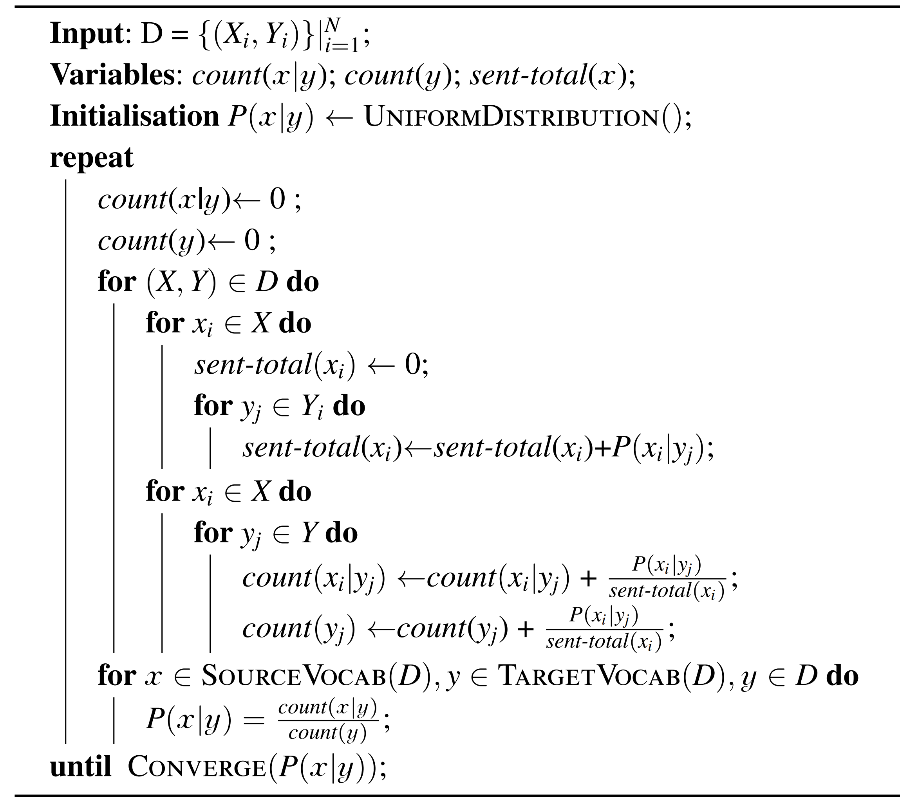
IBM model 1

Slide 50
Contents
6.1 Expectation Maximization
6.1.1 Introduction
6.1.2 EM
6.1.3 Relationships between MLE and EM
6.2 Using EM
6.2.1 Unsupervised Naïve Bayes model
6.2.2 IBM Model 1
6.2.3 Probabilistic latent semantic analysis
6.2.4 The relative advantages of generative models
6.3 EM theory
6.3.1 EM and KL-Divergence
6.3.2 EM derivation using numerical optimization

Slide 51
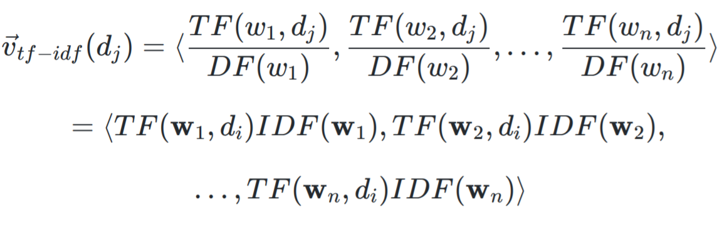
Document representation
Document-word correlation
But words are sparse.

Slide 52


Probabilistic Latent Semantic Analysis
PLSA is a generative model for document semantic analysis.
Topics are hidden variables .
Document-topic distribution $P(h|d_{i})$
Topic-word distribution $P(w|h)$

Slide 53



Probabilistic Latent Semantic Analysis
For every document $d$, for every position $l$:
1. select a document $d_{i}$ from $P(d_{i})$
2. generate a topic $h_{j}$ from $P(h_{j}|d)$
3. generate a word $w_{j}$ from $P(w|h_{j})$

Slide 54

Probabilistic Latent Semantic Analysis
Model target $P(w,h|d)=P(h|d)P(w|h,d)$
Hidden variable posteria probability
$P\left(h | d_{i},w,Θ^{t}\right)=\frac{P\left(h,d_{i},w | Θ^{t}\right)}{P\left(d_{i},w | Θ^{t}\right)}=\frac{P\left(h | d_{i},Θ^{t}\right)P\left(w | h,Θ^{t}\right)}{\sum_{h^{′}}{P\left(h^{′} | d_{i},Θ^{t}\right)P\left(w | h^{′},Θ^{t}\right)}}$
The Q-function:
$Q\left(Θ,Θ^{t}\right)=\sum_{i=1}^{N}{\sum_{w∈d_{i}}{\sum_{h}{P\left(h | d_{i},w,Θ^{t}\right)logP\left(h,d_{i},w | Θ\right)}}}$
$=\sum_{i=1}^{N}{\sum_{w∈V}{C\left(w,d_{i}\right)\sum_{h}{P\left(h | d_{i},w,Θ^{t}\right)\left[logP\left(h | d_{i},Θ\right)+logP\left(w | h,Θ\right)\right]}}}$
Constraints:
$\sum_{h}{P\left(h | d_{i},Θ\right)=1}$ , $\sum_{w}{P\left(w | h,Θ\right)=1}$

Slide 55

Probabilistic Latent Semantic Analysis
Define a Lagrangian function
$$Λ\left(Θ,λ\right)=Q\left(Θ,Θ^{t}\right)−\sum_{i}{λ_{d_{i}}\left(\sum_{h}{P\left(h | d_{i},Θ\right)}−1\right)}−\sum_{h}{λ_{h}\left(\sum_{w}{P\left(w | h,Θ\right)}−1\right)}$$
Consider $\frac{∂Λ\left(Θ,λ\right)}{∂P\left(h | d_{i},Θ\right)}=0$ and $\sum_{h}{P\left(h | d_{i},Θ\right)}−1=0$
$$P\left(h | d_{i},Θ\right)=\frac{\sum_{w∈V}{C\left(w,d_{i}\right)P\left(h | d_{i},w,Θ^{t}\right)}}{\sum_{w∈V}{C\left(w,d_{i}\right)}}$$
$$P\left(w | h,Θ\right)=\frac{\sum_{i=1}^{N}{C\left(w,d_{i}\right)P\left(h | d_{i},w,Θ^{t}\right)}}{\sum_{i=1}^{N}{\sum_{w∈V}{C\left(w,d_{i}\right)P\left(h | d_{i},w,Θ^{t}\right)}}}$$

Slide 56
Contents
6.1 Expectation Maximization
6.1.1 Introduction
6.1.2 EM
6.1.3 Relationships between MLE and EM
6.2 Using EM
6.2.1 Unsupervised Naïve Bayes model
6.2.2 IBM Model 1
6.2.3 Probabilistic latent semantic analysis
6.2.4 The relative advantages of generative models
6.3 EM theory
6.3.1 EM and KL-Divergence
6.3.2 EM derivation using numerical optimization

Slide 57

Jensen inequality
Goal: maximize
$$P\left(O | Θ\right)=\sum_{H}{P(O,H|Θ)}$$
$$logP\left(O | Θ\right)=log\sum_{H}{P(O,H|Θ)}$$

Slide 58


Jensen inequality
for concave functions, $E\left(g\left(μ\right)\right)≥g\left(E\left(μ\right)\right)$,
for convex functions, $E\left(g\left(μ\right)\right)≤g\left(E\left(μ\right)\right).$

Slide 59

Using Jensen inequality
Goal: maximize
$P\left(O | Θ\right)=\sum_{H}{P(O,H|Θ)}$
$L\left(Θ\right)=log\sum_{h}{P\left(O,h | Θ\right)}=\log{\sum_{h}{\frac{P_{C}\left(h\right)P\left(O,h | Θ\right)}{P_{C}\left(h\right)}}}$= $log\sum_{h}{P_{C}\left(h\right)f(Θ)}$
$≥\sum_{h}{P_{C}\left(h\right)logf\left(Θ\right)}=\sum_{h}{P_{C}\left(h\right)\log{\frac{P\left(O,h | Θ\right)}{P_{C}\left(h\right)}}}=F\left(Θ,P_{C}\right)$,
$F\left(Θ,P_{C}\right)$ is a lower bound of $L(Θ)$

Slide 60





KL-divergence
$F\left(Θ,P_{C}\right)=L\left(Θ\right)−KL\left(P_{C}\left(h\right),P\left(h | O,Θ\right)\right)$
KL-divergence is always non-negative
$KL(P,Q)$ is zero if and only if $P=Q$
To make the bound as tight as possible, $P_{C}\left(h\right)=P\left(h | O,Θ\right)$
In this scenario, $F\left(Θ,P_{C}\right)=L\left(Θ\right)$

Slide 62
Contents
6.1 Expectation Maximization
6.1.1 Introduction
6.1.2 EM
6.1.3 Relationships between MLE and EM
6.2 Using EM
6.2.1 Unsupervised Naïve Bayes model
6.2.2 IBM Model 1
6.2.3 Probabilistic latent semantic analysis
6.2.4 The relative advantages of generative models
6.3 EM theory
6.3.1 EM and KL-Divergence
6.3.2 EM derivation using numerical optimization

Slide 63

EM derivation using numerical optimization
Another way to maximizes $F(Θ,P_{C})$
Coordinate ascent
Expectation step.
finds an optimum distribution $P_{C}(H)$ that maximizes $F(Θ^{t},P_{C})$
Maximization step.
finds the optimal $Θ^{t+1}$ for $F(Θ,P_{C}^{t+1})$ using $P_{C}^{t+1}$.

Slide 65



EM derivation using numerical optimization
Convergence.
after every iteration of E-step and M-step, $L\left(Θ^{t+1}\right)−L\left(Θ\right)≥0$,
$L(Θ)$ is a monotonically increasing function, EM is guaranteed to converge to local optima.

Slide 66
Summary
The concept of hidden variables
Expectation Maximization (EM) algorithm
The correlation between EM and MLE for training probabilistic models
EM for unsupervised text classification
IBM model 1 for statistical machine translation
Probabilistic latent semantic allocation

